Slide 1
Enhancing Generative Adversarial Networks (GANs) with CMD-GAN
Subtitle:A Novel Approach for Mode Collapse Mitigation and Improved Image Agumentation

Slide 2
Table Of Contents:
Abstract
Introduction
Wasserstein Generative Adversarial Network (WGAN)
Related Works/Existing Works
Proposed Approach: CMD-GAN
Algorithm
Experiments
Formulas Used
Comparative Analysis
System Hardware
Results
Graph Comparison of GANs
Conclusion
Future Directions
References
Questions and Answers

Slide 3
Abstract
Generative Adversarial Networks (GANs) have transformed deep learning by generating high-fidelity synthetic data, yet face challenges like mode collapse and training instability. The Wasserstein GAN (WGAN) improved stability but still struggles with mode collapse. We introduce CMD-GAN ("Concatenate, Mix and Differentiate"), designed for data augmentation by altering image backgrounds. CMD-GAN demonstrates smoother convergence, reduced discriminator loss, and increased generator loss, indicating effective mode collapse mitigation. This presentation explores CMD-GAN's architecture, training, and results, highlighting its potential to overcome traditional GAN limitations and advance generative modeling research.

Slide 4
Introduction
Introduction to Generative Adversarial Networks (GANs).
A Generative Adversarial Network (GAN) is a type of machine learning framework invented by Ian Goodfellow and his colleagues in 2014. It's composed of two neural networks, called the generator and the discriminator, which compete against each other.
Challenges faced by traditional GANs (mode collapse, training instability, evaluation metrics).

Slide 5
Wasserstein Generative Adversarial Network (WGAN)
Purpose: Introduced to address limitations of traditional GANs, such as mode collapse and training instability.
Key Innovation: Utilizes the Wasserstein distance to enhance stability and convergence during training.
Advancement: Offers significant improvements in training dynamics and the generation of more realistic synthetic data.
Limitation: Despite advancements, WGAN’s still encounter the mode collapse problem, necessitating further improvements.

Slide 6
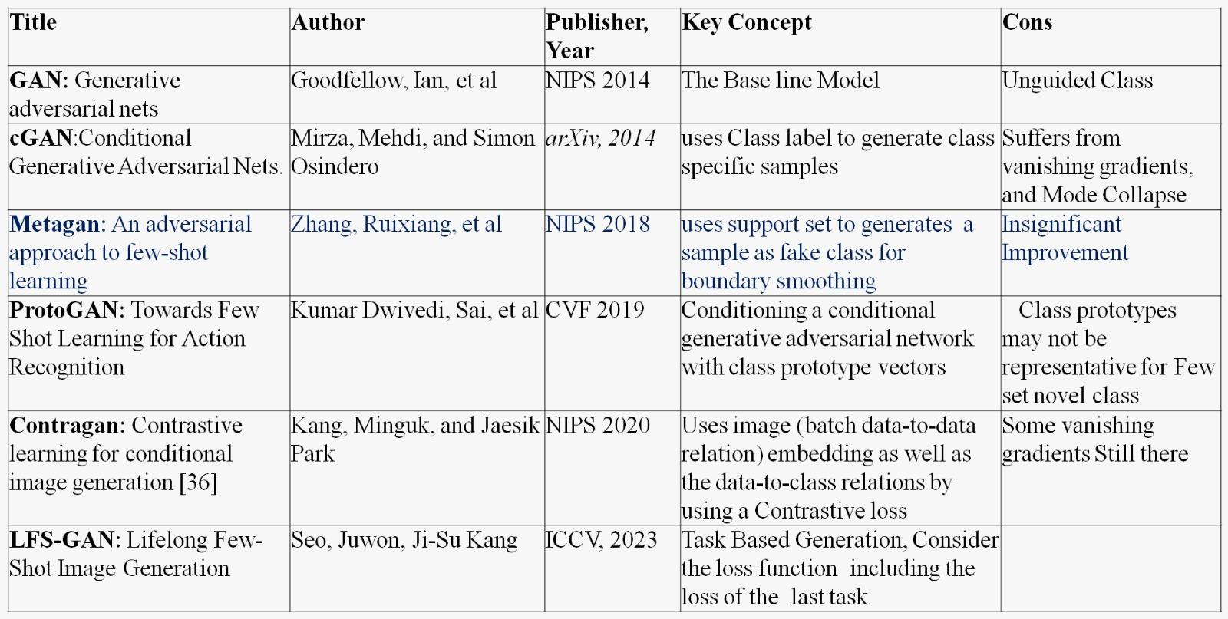
Related Works/Existing Works

Slide 7
Proposed Approach: CMD-GAN
Purpose: Developed to overcome limitations of traditional GANs, such as mode collapse and training instability.
Innovative Approach: Designed for data augmentation using pairs of inputs, one for the foreground and one for background changes.
Key Features:
Smoother Convergence: Demonstrates improved training stability.
Performance Metrics: Reduced discriminator loss and increased generator loss indicate effective mode collapse mitigation.
Significance: CMD-GAN offers a promising solution to traditional GAN challenges, enhancing the field of generative modeling and opening avenues for future research.

Slide 8
Algorithm
Step-1: Initialization
Set up the environment and import necessary libraries.
Load and preprocess mini-ImageNet dataset (train, validation, test).
Define the Convolutional Neural Network (CNN) architecture for the generator and discriminator models.
Define custom loss functions and data augmentation functions.
Step-2:Data Preprocessing
Normalize the input images.
Apply a mask to the images to introduce noise.
Create data generators for train, validation, and test datasets using the Data_GeneratorRaviLabel class
The data generator class is responsible for sampling images and creating batches for training.

Slide 9
Step-3:Model Definition
Define the generator model (make_generator_model):
Sequential CNN layers with normalization and activation functions.
Output layer with sigmoid activation to generate images.
Define the discriminator model (make_discriminator_model):
Sequential CNN layers with normalization and activation functions.
Output a decision score for real vs. generated images.
Step-4:Training Functions Define custom distance functions (cosine_distances, proto_dist, etc.).
Define the training step function (train_step):
Compute discriminator loss on real and generated images.
Compute generator loss using custom distance functions.
Compute gradients and update model weights.

Slide 10
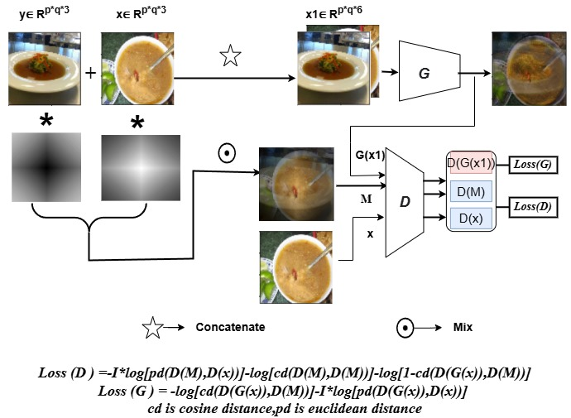
Model Architecture Diagram
In FSL training, this augmentation is more useful because the
complementary is the next closest image within the episode
which may which reduces the differences and
leads to deeper learning.

Slide 11
Step-5: Training Loop:
Initialize optimizers for generator and discriminator.
Train the models for a specified number of epochs:
Iterate over batches from the data generator.
Update generator and discriminator using the training step function.
Log and print the losses for monitoring.
Step-6: Evaluation:
Generate and visualize sample images from the generator.
Save the trained models and plot the training losses.

Slide 12
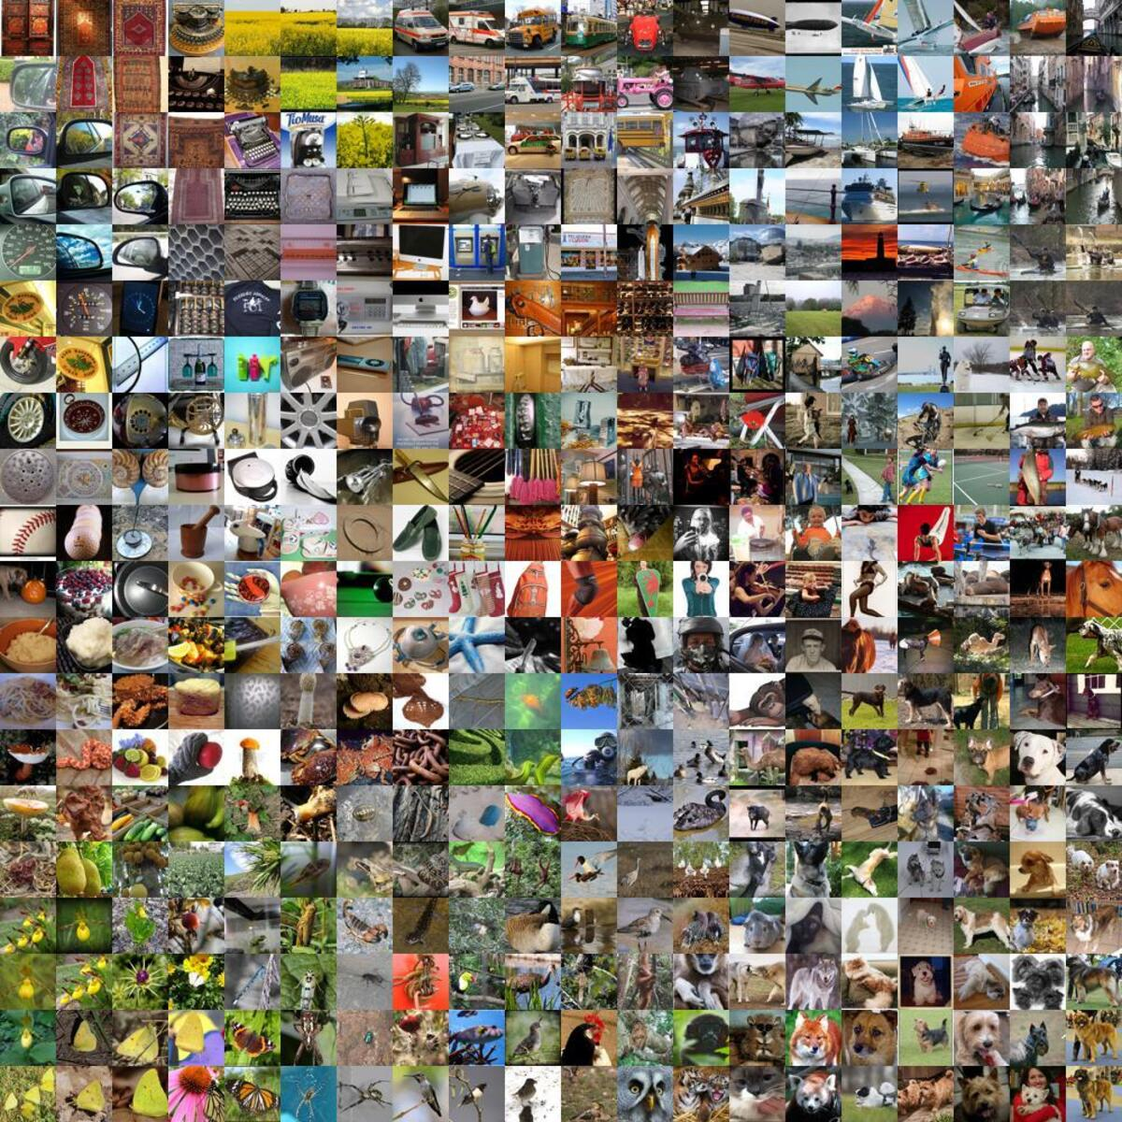
Experiments - Datasets Used
Libraries Used: Tensorflow, Keras, Numpy, Random, Math, Cv2, Matplotlib MiniImageNet Dataset:

Slide 13
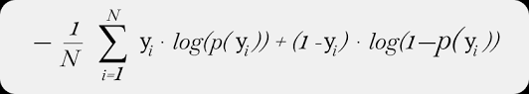
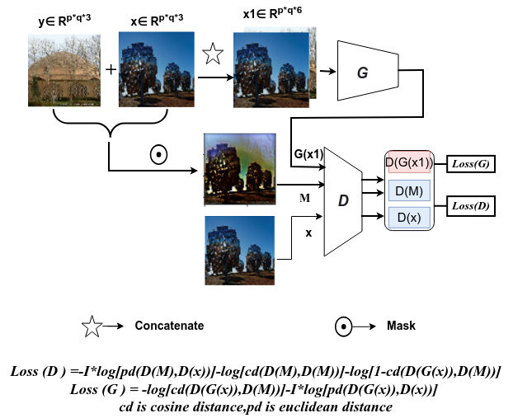
Formulas Used :
Standard GAN and Wasserstein GAN:
CMD-GAN:

Slide 14
Experiments - Comparative Analysis
Comparison with traditional GANs and WGANs
Evaluation metrics: Mode collapse mitigation and image quality improvement

Slide 15
System Hardware:
Google Colab TP4 GPU
System RAM Used: 7.5 / 12.7 GB
GPU RAM Used: 1.6 / 15 GB
Disk Used: 34.2 / 112.6 GB

Slide 16
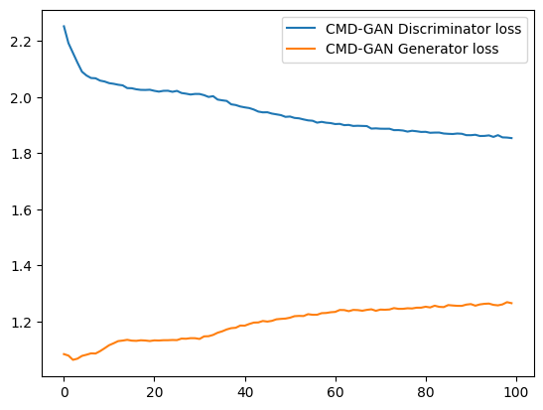
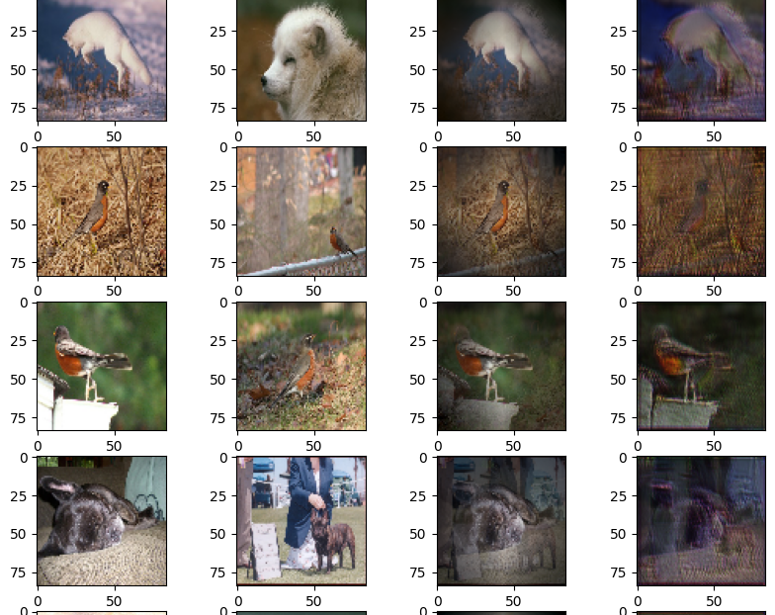
Result
CMD-GAN Results

Slide 17
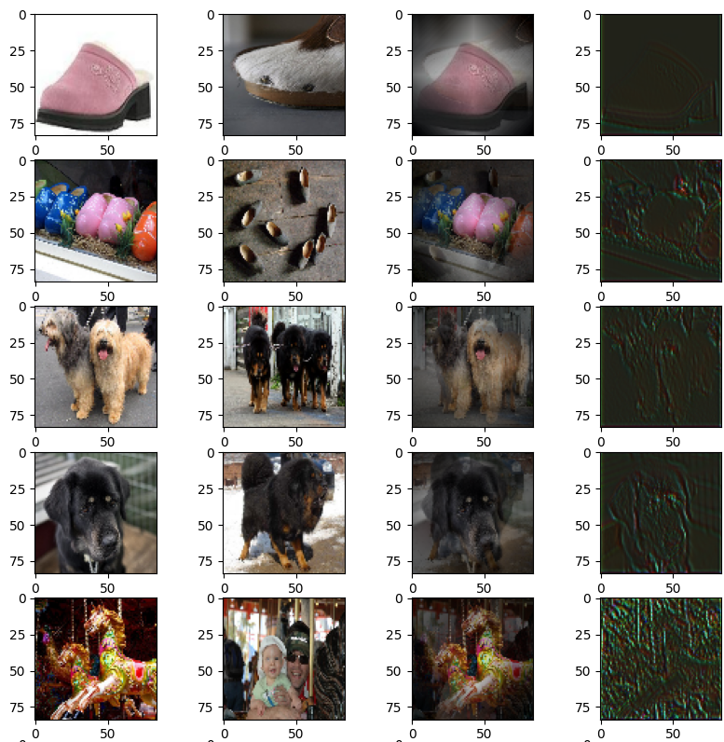
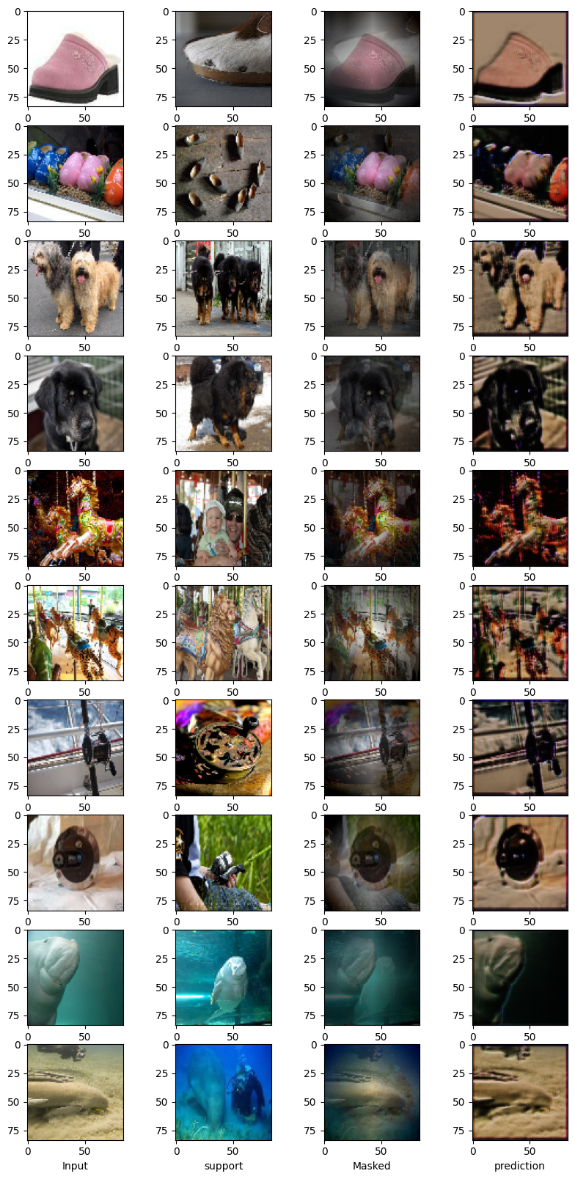
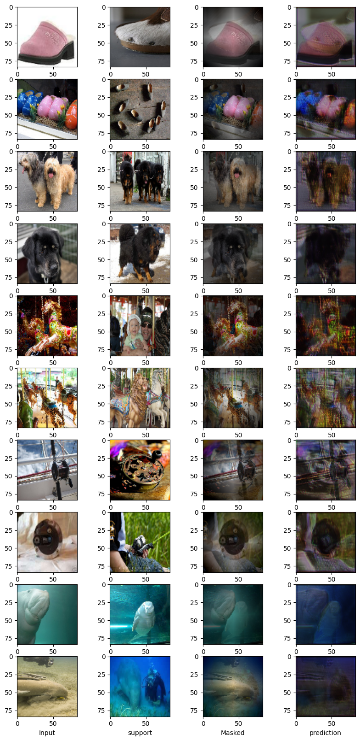
Results comparison with other approaches:
Standard_GAN W_GAN CMD-GAN

Slide 18
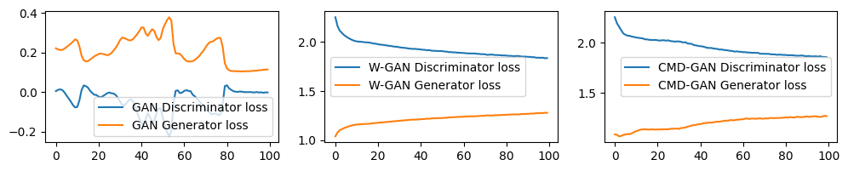
Graph Comparison Of GAN’s:

Slide 19
Question and Answers?

Slide 20
Conclusion
Summary of CMD-GAN's contributions
Advancements over traditional GANs and WGAN’s
Future potential in generative modeling and data augmentation

Slide 21
Future Directions
Areas for future research and development
Potential applications and extensions of CMD-GAN

Slide 22
References
https://colab.research.google.com/gist/Bhargavpitta/eeefd7674b164239a13fa01650927a37/copy_of_fsl_generative_adversarial_encoder.ipynb

Slide 23
Speech-to-Speech Bot Using LLM

Slide 24
Table Of Contents
Introduction
Technology Stack
System Architecture
Speech-to-Text Process
Gemini LLM
Generative Model Parameters
Text-to-Speech Process
Challenges and solutions
Future Enhancements
Conclusion
References

Slide 25
Introduction
Objective: Develop a speech-to-speech application utilizing Large Language Model(LLM) technology. This project aims to create an interactive bot capable of processing spoken input and generating spoken responses.
Speech-to-Text Conversion: Transcribe user speech accurately into text using speech_recognition.
Generative AI Responses: Leverage Gemini Flash to generate intelligent, context-aware responses.
Text-to-Speech Output: Convert generated text into clear, natural-sounding speech using pyttsx3.
Interactive Web UI: Streamlit interface for user interaction and conversation tracking.
Conversation History: Maintain a record of user inputs and AI responses for reference.

Slide 26
Technology Stack
Streamlit: Framework for creating an interactive and visually appealing UI.
Speech Recognition: Python's speech_recognition library for real-time speech-to-text processing.
Text-to-Speech: pyttsx3 for converting text into speech with adjustable voice and speed settings.
Generative AI: Google Gemini Flash API for generating responses based on user queries.
APIs and Integration: Discuss the importance of integrating APIs for seamless interaction between components.

Slide 27
System Architecture
Text
Streamlit Interface(UI) - Session state - Conversation History
Speech
Input
Through mircophone
1. Speech recognition
2. Generative Model (Gemini)
3. Text-to-Speech Engine(ptttsx3)
Speech Output
Text
Text
Input Layer
Processing Layer
Output Layer

Slide 28
Speech-to-Text Process
Input Parsing
Tokenization and input parsing divide text into meaningful chunks, such as words and phrases.
Phonetic Transcription
The process of phonetic transcription transforms text into phonemes, which are the smallest units of sound.
Makes sure the pronunciation is correct.
Prosody Generation
For genuine speech, prosody generation incorporates organic changes in intonation, pitch, and duration.
Voice Synthesis
Produces voice waveforms by techniques such as concatenative synthesis.
It is a parametric synthesis.
The synthesis of neural waveforms (e.g., WaveNet).
Output Playback
As the last stage, output playback plays the generated audio.

Slide 29
Gemini LLM
Processing Layer: Large Language Model (LLM)
Component: Gemini Flash Model (via google.generativeai)
Functionality:
Receives text input (user's recognized speech).
Processes input using the Gemini model to generate a contextually relevant response.
Data Flow:
Text input → Gemini Model → Generated response text.

Slide 30
Generative Model Parameters
Temperature:
Controls randomness in the output.
Lower values (e.g., 0.2) make responses more focused and deterministic.
Higher values (e.g., 1.0) make responses more creative and diverse.
Top-p (Nucleus Sampling):
Limits the output to the smallest set of words whose cumulative probability is above a threshold (e.g., 0.9).
Ensures the model considers only the most probable options, balancing creativity and relevance.
Top-k:
Limits the output to the top k most likely tokens (e.g., k=50).
Prevents the model from considering less likely options, making responses more focused.
Max Output Tokens:
Sets the maximum length of the response in tokens (e.g., 200 tokens).
Ensures concise and controlled outputs.
These parameters fine-tune the generative behavior, balancing precision, creativity, and response length.

Slide 31
Text-to-Speech Process
Text Preprocessing:
The input text is normalized (removing special characters, expanding abbreviations, etc.).
Text is segmented into phonemes or words for easier processing.
Linguistic Analysis:
Determines pronunciation, intonation, and rhythm based on the language's rules.
Handles homophones and context-specific pronunciations.
Voice Synthesis:
Uses a pre-trained model (such as concatenative synthesis, parametric synthesis, or neural-based TTS like WaveNet) to generate speech audio.
Converts the processed text into sound waves.
Audio Output:
The generated sound wave is played using speakers or saved as an audio file.

Slide 32
Challenges and Solutions
Speech Recognition Accuracy:
Challenge: Background noise affecting transcription.
Solution: Ambient noise adjustment and clear user prompts.
API Integration:
Challenge: Handling latency and timeout issues with Gemini Flash.
Solution: Implementing error handling and retry mechanisms.
TTS Playback:
Challenge: Managing overlapping playback sessions in pyttsx3.
Solution: Explicitly stopping the loop before starting a new one.
UI Responsiveness:
Challenge: Ensuring real-time updates in Streamlit.
Solution: Efficient session state management.

Slide 33
Future Enhancements
Multilingual Support:
Add support for multiple languages in speech recognition, LLM responses, and TTS.
Improved Context Handling:
Enable the bot to retain conversational context over multiple turns.
Advanced Voice Modulation:
Allow users to customize the bot’s voice (e.g., tone, speed, and emotion).
Enhanced UI:
Add features like voice playback controls, custom prompts, and more detailed history views.
Integration with IoT:
Enable the bot to control smart devices via voice commands.

Slide 34
Conclusion
Project Summary: Recap of the bot's capabilities and the technologies involved.
Impact: Highlight the potential benefits for users and industries.
Lessons Learned: Share key insights from development challenges and solutions.
Call to Action: Invite feedback and encourage adoption or collaboration for future improvements

Slide 35
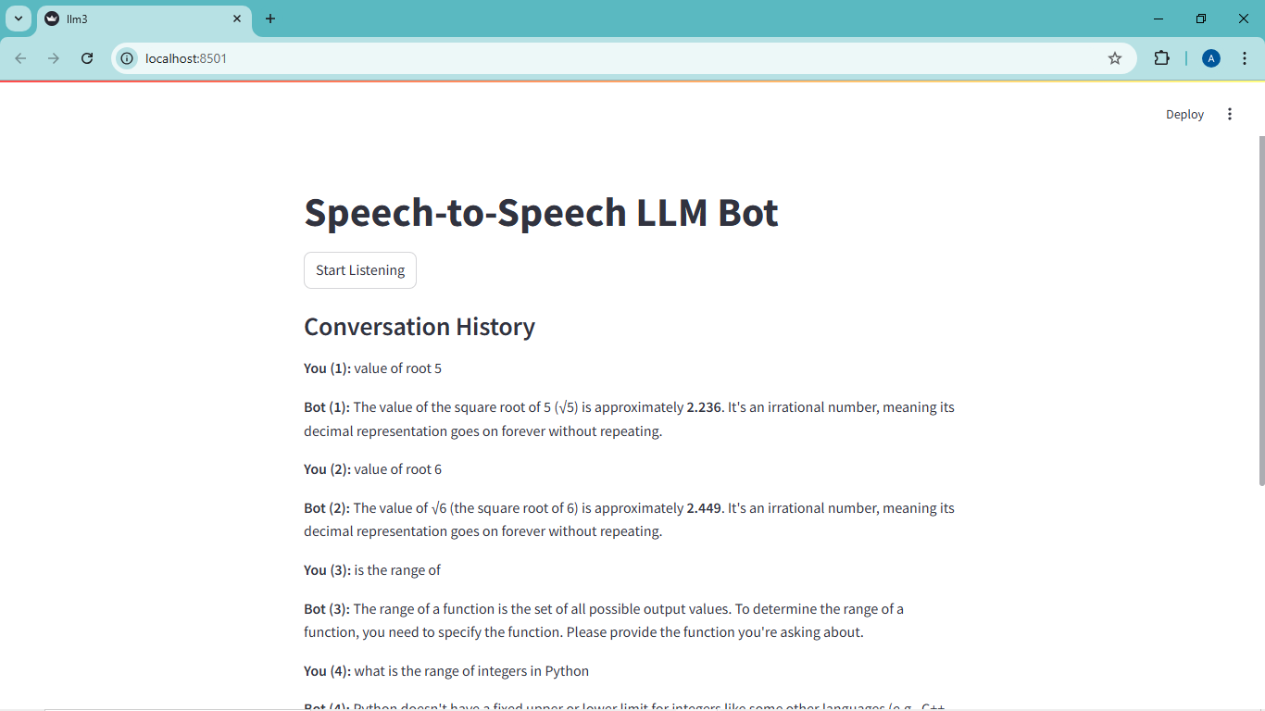

Slide 36
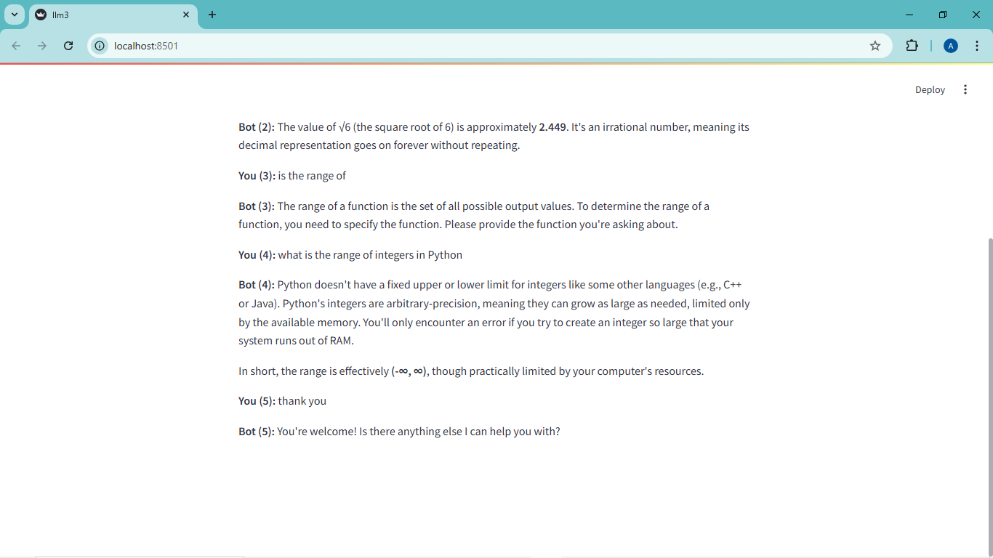

Slide 37
References
Libraries:
Streamlit: https://streamlit.io
speech_recognition: https://pypi.org/project/SpeechRecognition
pyttsx3: https://pypi.org/project/pyttsx3

Slide 38
Thank you

